Slide 1
DBDA.X408 Introduction to Machine Learning and Data Mining
What is Machine Learning?
Real-life machine learning example from the banking industry
Excuse to introduce some jargon
Bob’s fate is decided by this piece of software
Working definition: Oh… So, this is machine learning?
Working definition: Is that all there is to it?
Supervised Learning
Unsupervised Learning
Face Emotion Classification
Market Segmentation (Data)
Market Segmentation (K=15, Kmeans Clustering)
Machine Learning versus Other Things
When to use machine learning (versus other things)
One more … Reinforcement Learning
Bayesian Classifiers: An insightful (and abysmally silly) example
The Histogram-Pair Classifier
The use of mathematical models of data distribution
The mathematical models are described using formulas
Bayesian Formulas
Why are these slightly modified formulas “more” correct?
Understanding probability density functions (PDFs)
Why are these slightly modified formulas “more” correct?
Bayesian Formulas (with textbook notation)
Multi-class, multidimensional generalizations
Don’t these textbook formulas look less daunting?
Assignment
How is a histogram constructed?
Pseudocode for computing the histogram
How does Alice’s software work?
How does unsupervised learning work?
Topic 1 Summary

Slide 2
What is Machine Learning?
Machine learning is the science of creating functioning computer-based systems without explicit predetermined specifications.
Traditional Computation
Study of domain knowledge
Models based on
Physics, Chemistry, Biology …
Algorithm Development
Algorithm with performance guarantees
Machine Learning
Data acquisition
Training set creation
Learning
Black-box machine
Domain knowledge
Tunable model

Slide 3
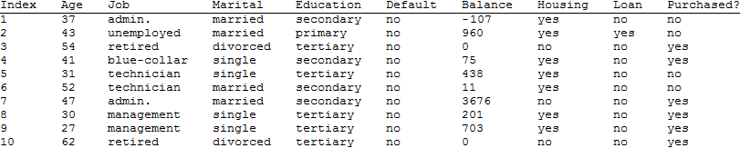
Real-life machine learning example from the banking industry
The machine learning problem
Alice works in a bank that actively sells loans.
She needs to meet her daily sales quota.
She has basic information on Bob, including his phone number.
She is worried that she will have to spend 30 minutes talking to Bob with no guarantee of closing any deal.
Should she call Bob, or move on to the next potential customer?
A look at some of the data (partial)
S. Moro, R. Laureano and P. Cortez. Using Data Mining for Bank Direct Marketing: An Application of the CRISP-DM Methodology. In P. Novais et al. (Eds.), Proceedings of the European Simulation and Modelling Conference - ESM'2011, pp. 117-121, Guimarães, Portugal, October, 2011. EUROSIS.
A new candidate's financial variables must be compared against entries in a huge database and a prediction must be computed.

Slide 4
Excuse to introduce some jargon
Training Set
Ordinal
Nominal
Nominal
Nominal
Nominal
Ordinal
Nominal
Nominal
Class label
Features
Feature Vector

Slide 5
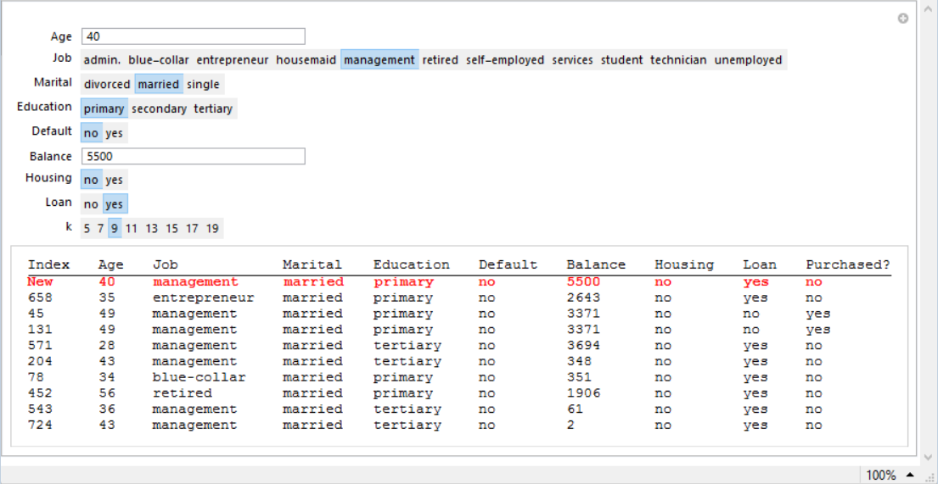
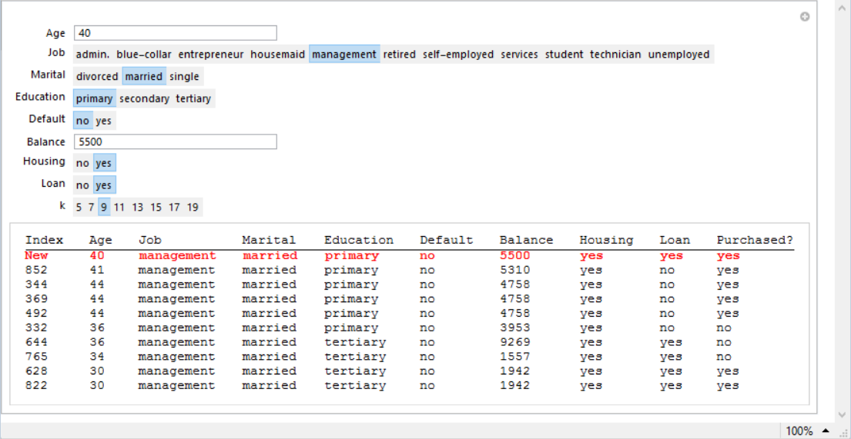
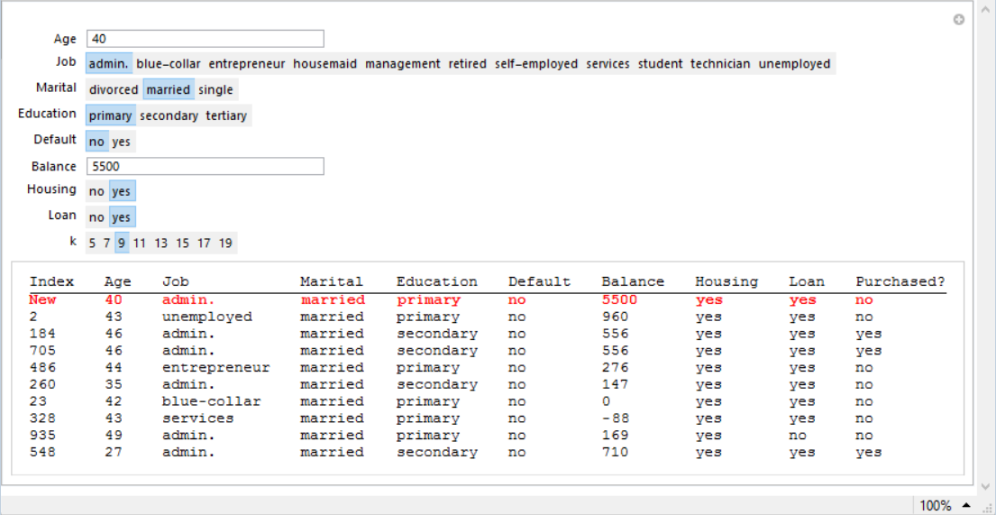
Bob’s fate is decided by this piece of software
Query
Prediction

Slide 6
Working definition: Oh… So, this is machine learning?
Classifier Usage
Classifier
Feature Vector
Output Class Label
Classifier Design
Learning Algorithm
Training set
Classifier
(Feature Vectors+
Known Class Labels)
This is also known as supervised learning (learning from labeled examples)

Slide 7
Working definition: Is that all there is to it?
Classifier Usage
Feature Vectors
Classifier
Groupings or
Clusters
This is also known as unsupervised learning (learning without labeled examples)

Slide 8
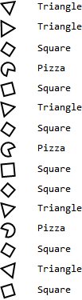



Supervised Learning
Training set
Classifier
Query
Result
Too easy! Query has exact match in the training set
Classifier
Query
Result
To be practically useful, a classifier must have the ability to generalize on learning from training examples
Classifier
Query
Result
Supervised learning: You teach the system by showing it examples

Slide 9


Unsupervised Learning
No class labels provided
Unsupervised learning algorithm produces groupings
A human may examine the groupings to understand the significance. E.g.
1 → Triangle
2 → Square
3 → Pizza
Unsupervised learning: Let the system discover what can be learned

Slide 10

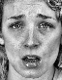
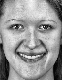


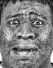




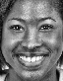
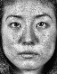



Face Emotion Classification
Training set
Queries
Neutral
Sad
Happy
Neutral
Sad
Happy

Slide 11
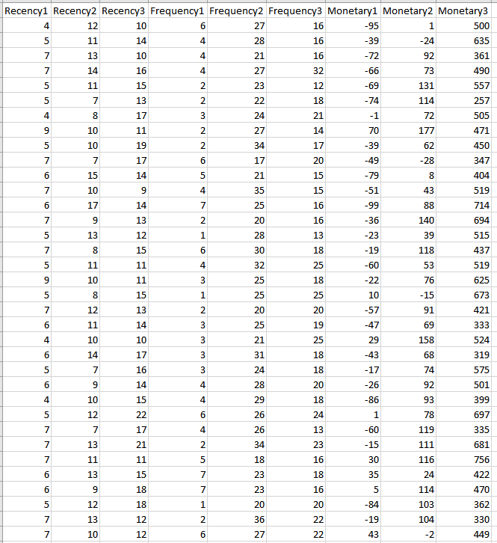
Market Segmentation (Data)

Slide 12

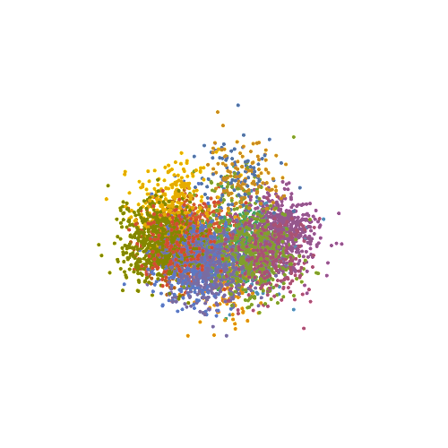
Market Segmentation (K=15, Kmeans Clustering)

Slide 13
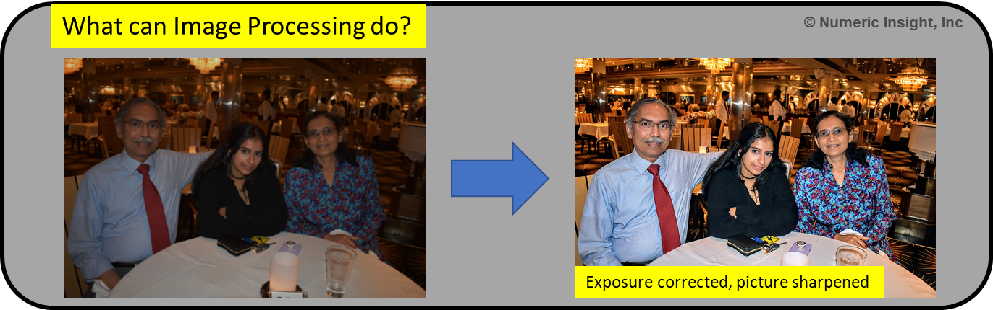
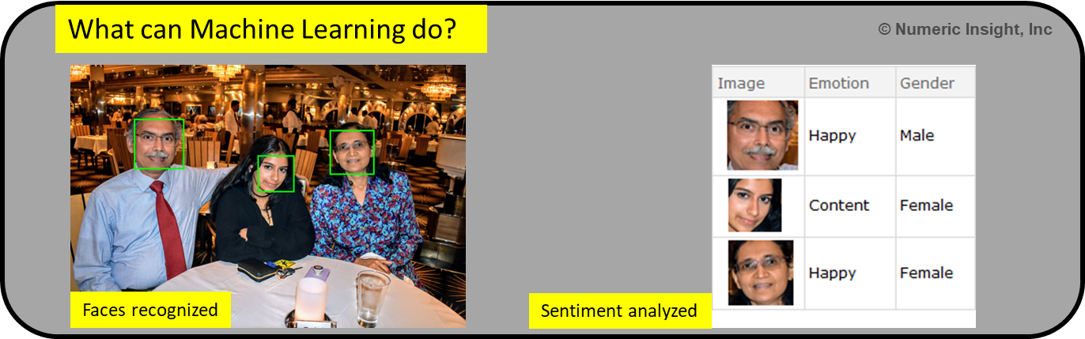
Machine Learning versus Other Things

Slide 14
When to use machine learning (versus other things)
When traditional engineering or scientific methodology is not applicable or is impractical. E.g. when a physics-based model is unavailable, or is too complex
When a large amount of data can be collected with reasonable effort
When a black box solution is acceptable
When the system being learned is stationary for a sufficiently long period of time

Slide 15
One more … Reinforcement Learning
Environment
Reward
State
Action
Agent
Action
State
Reward
Reward
State
Action
Action
State
Reward
Extremely important (and complex) topic with applications in robotics, logistics, trading etc

Slide 16
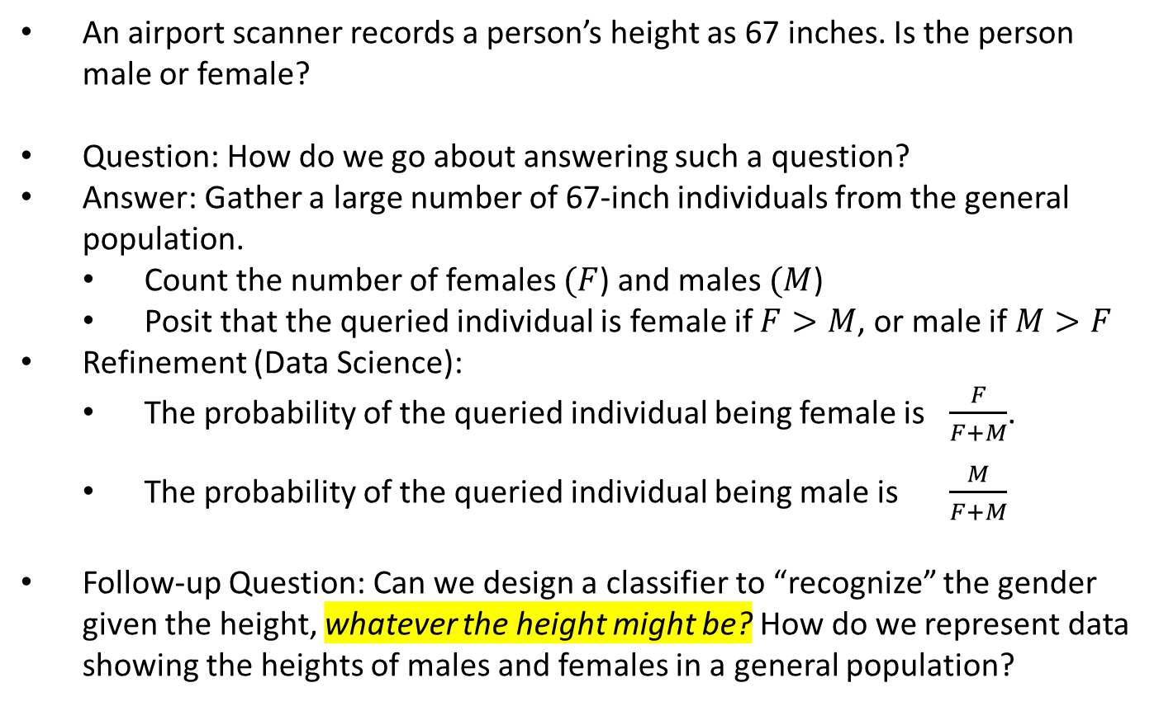
Bayesian Classifiers: An insightful (and abysmally silly) example
An airport scanner records a person’s height as 67 inches. Is the person male or female?
Question: How do we go about answering such a question?
Answer: Gather a large number of 67-inch individuals from the general population.
Count the number of females $(F$) and males $(M$)
Posit that the queried individual is female if $F>M$, or male if $M>F$
Refinement (Data Science):
The probability of the queried individual being female is $\frac{F}{F+M}$.
The probability of the queried individual being male is $\frac{M}{F+M}$
Follow-up Question: Can we design a classifier to “recognize” the gender given the height, whatever the height might be? How do we represent data showing the heights of males and females in a general population?
Note: This is not merely a textbook exercise. Biometric systems used in security and authentication actually use the concepts described here.

Slide 17
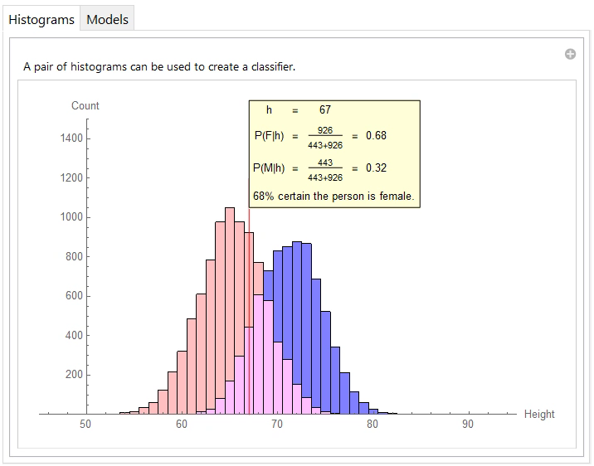
The Histogram-Pair Classifier

Slide 18
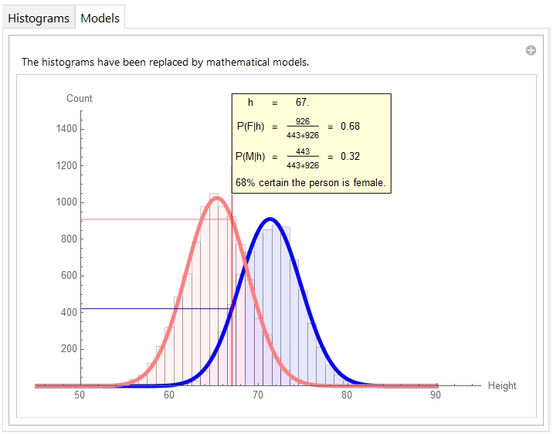
The use of mathematical models of data distribution

Slide 19

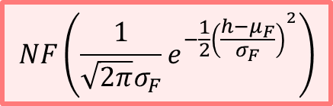
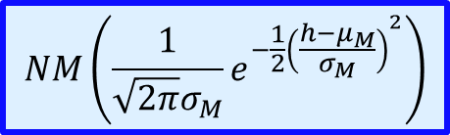
The mathematical models are described using formulas
Most classifiers work by computing such probabilities and picking the class with the highest probability.
$$NF\left(\frac{1}{\sqrt{2π}σ_{F}}e^{−\frac{1}{2}{\left(\frac{h−μ_{F}}{σ_{F}}\right)}^{2}}\right)$$
$$NM\left(\frac{1}{\sqrt{2π}σ_{M}}e^{−\frac{1}{2}{\left(\frac{h−μ_{M}}{σ_{M}}\right)}^{2}}\right)$$

Slide 20
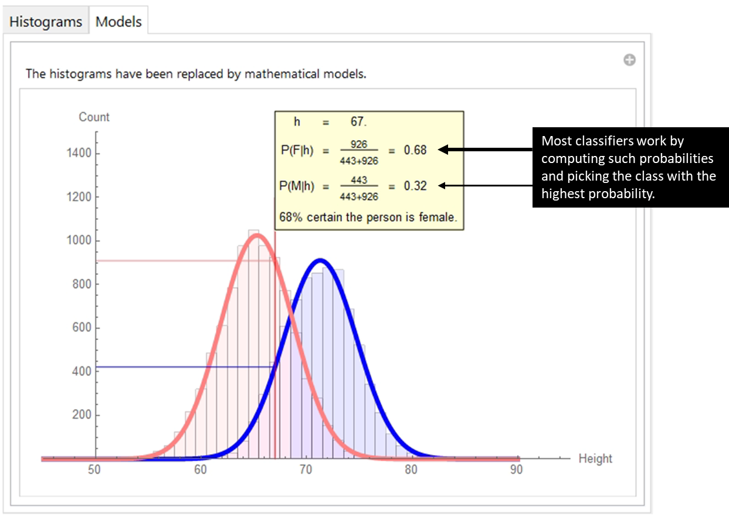

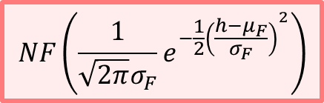
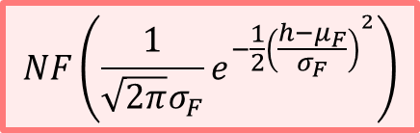
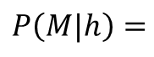

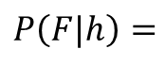
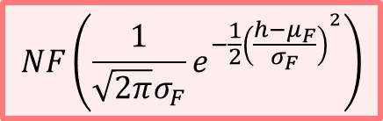
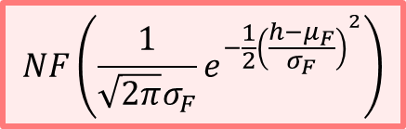
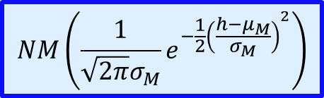
Bayesian Formulas
$$NF\left(\frac{1}{\sqrt{2π}σ_{F}}e^{−\frac{1}{2}{\left(\frac{h−μ_{F}}{σ_{F}}\right)}^{2}}\right)$$
$$P\left(F|h\right)=$$
$$NF\left(\frac{1}{\sqrt{2π}σ_{F}}e^{−\frac{1}{2}{\left(\frac{h−μ_{F}}{σ_{F}}\right)}^{2}}\right)$$
+
$$NM\left(\frac{1}{\sqrt{2π}σ_{M}}e^{−\frac{1}{2}{\left(\frac{h−μ_{M}}{σ_{M}}\right)}^{2}}\right)$$
$$NF\left(\frac{1}{\sqrt{2π}σ_{F}}e^{−\frac{1}{2}{\left(\frac{h−μ_{F}}{σ_{F}}\right)}^{2}}\right)$$
$$NF\left(\frac{1}{\sqrt{2π}σ_{F}}e^{−\frac{1}{2}{\left(\frac{h−μ_{F}}{σ_{F}}\right)}^{2}}\right)$$
$$NM\left(\frac{1}{\sqrt{2π}σ_{M}}e^{−\frac{1}{2}{\left(\frac{h−μ_{M}}{σ_{M}}\right)}^{2}}\right)$$
$$NM\left(\frac{1}{\sqrt{2π}σ_{M}}e^{−\frac{1}{2}{\left(\frac{h−μ_{M}}{σ_{M}}\right)}^{2}}\right)$$
$$P\left(M|h\right)=$$
$$NF\left(\frac{1}{\sqrt{2π}σ_{F}}e^{−\frac{1}{2}{\left(\frac{h−μ_{F}}{σ_{F}}\right)}^{2}}\right)$$
+
$$NM\left(\frac{1}{\sqrt{2π}σ_{M}}e^{−\frac{1}{2}{\left(\frac{h−μ_{M}}{σ_{M}}\right)}^{2}}\right)$$

Slide 21
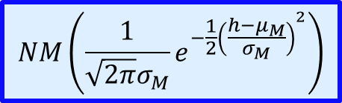
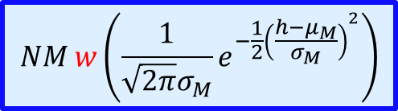
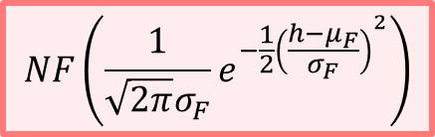

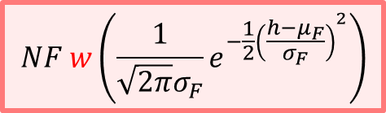

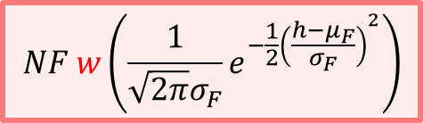
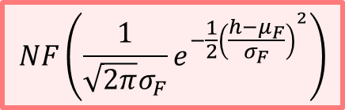
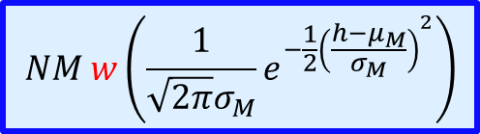
Why are these slightly modified formulas “more” correct?
$$NF w\left(\frac{1}{\sqrt{2π}σ_{F}}e^{−\frac{1}{2}{\left(\frac{h−μ_{F}}{σ_{F}}\right)}^{2}}\right)$$
$$NF\left(\frac{1}{\sqrt{2π}σ_{F}}e^{−\frac{1}{2}{\left(\frac{h−μ_{F}}{σ_{F}}\right)}^{2}}\right)$$
Probability Density Functions
$$P\left(F|h\right)=$$
$$NF w\left(\frac{1}{\sqrt{2π}σ_{F}}e^{−\frac{1}{2}{\left(\frac{h−μ_{F}}{σ_{F}}\right)}^{2}}\right)$$
$$NF\left(\frac{1}{\sqrt{2π}σ_{F}}e^{−\frac{1}{2}{\left(\frac{h−μ_{F}}{σ_{F}}\right)}^{2}}\right)$$
$$NM w\left(\frac{1}{\sqrt{2π}σ_{M}}e^{−\frac{1}{2}{\left(\frac{h−μ_{M}}{σ_{M}}\right)}^{2}}\right)$$
+
$$NM\left(\frac{1}{\sqrt{2π}σ_{M}}e^{−\frac{1}{2}{\left(\frac{h−μ_{M}}{σ_{M}}\right)}^{2}}\right)$$
$$NM w\left(\frac{1}{\sqrt{2π}σ_{M}}e^{−\frac{1}{2}{\left(\frac{h−μ_{M}}{σ_{M}}\right)}^{2}}\right)$$
$$NM\left(\frac{1}{\sqrt{2π}σ_{M}}e^{−\frac{1}{2}{\left(\frac{h−μ_{M}}{σ_{M}}\right)}^{2}}\right)$$
$$P\left(M|h\right)=$$
$$NF w\left(\frac{1}{\sqrt{2π}σ_{F}}e^{−\frac{1}{2}{\left(\frac{h−μ_{F}}{σ_{F}}\right)}^{2}}\right)$$
$$NF\left(\frac{1}{\sqrt{2π}σ_{F}}e^{−\frac{1}{2}{\left(\frac{h−μ_{F}}{σ_{F}}\right)}^{2}}\right)$$
$$NM w\left(\frac{1}{\sqrt{2π}σ_{M}}e^{−\frac{1}{2}{\left(\frac{h−μ_{M}}{σ_{M}}\right)}^{2}}\right)$$
+
$$NM\left(\frac{1}{\sqrt{2π}σ_{M}}e^{−\frac{1}{2}{\left(\frac{h−μ_{M}}{σ_{M}}\right)}^{2}}\right)$$

Slide 22
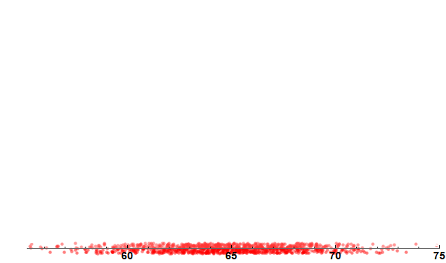
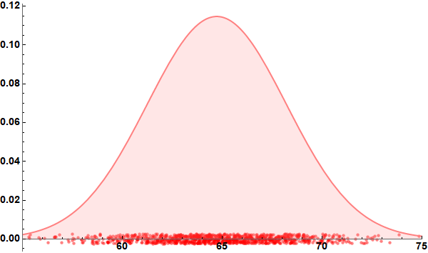
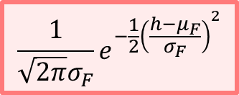
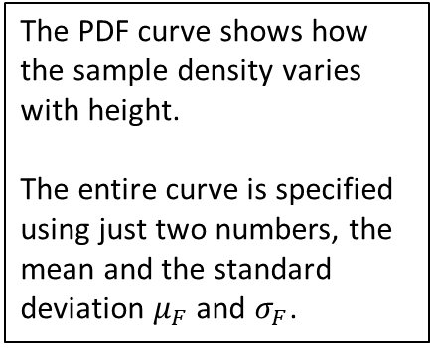
Understanding probability density functions (PDFs)
The PDF curve shows how the sample density varies with height.
The entire curve is specified using just two numbers, the mean and the standard deviation $μ_{F}$ and $σ_{F}$.
$$\frac{1}{\sqrt{2π}σ_{F}}e^{−\frac{1}{2}{\left(\frac{h−μ_{F}}{σ_{F}}\right)}^{2}}$$
Probability Density
Low density of samples
Medium density of samples
High density of samples
Medium density of samples
Low density of samples
Height in inches

Slide 23
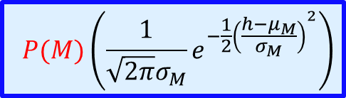
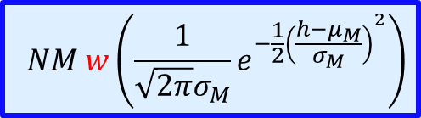
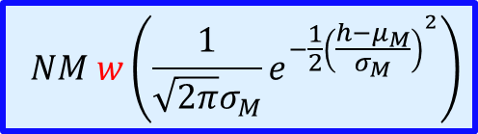
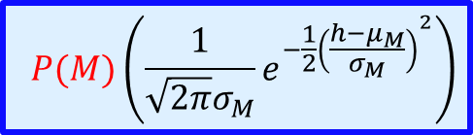

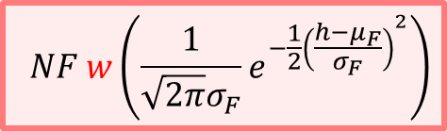
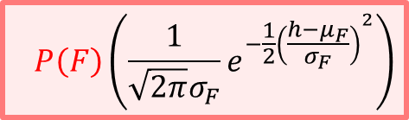

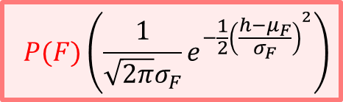
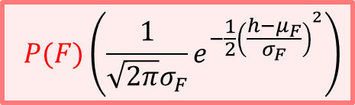
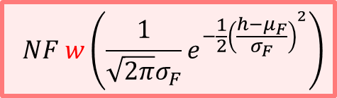
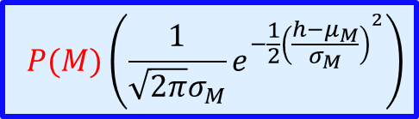
Why are these slightly modified formulas “more” correct?
$$NF w\left(\frac{1}{\sqrt{2π}σ_{F}}e^{−\frac{1}{2}{\left(\frac{h−μ_{F}}{σ_{F}}\right)}^{2}}\right)$$
A priori probabilities
$$P(F)\left(\frac{1}{\sqrt{2π}σ_{F}}e^{−\frac{1}{2}{\left(\frac{h−μ_{F}}{σ_{F}}\right)}^{2}}\right)$$
$$P\left(F|h\right)=$$
$$NF w\left(\frac{1}{\sqrt{2π}σ_{F}}e^{−\frac{1}{2}{\left(\frac{h−μ_{F}}{σ_{F}}\right)}^{2}}\right)$$
$$P\left(F\right)\left(\frac{1}{\sqrt{2π}σ_{F}}e^{−\frac{1}{2}{\left(\frac{h−μ_{F}}{σ_{F}}\right)}^{2}}\right)$$
$$NM w\left(\frac{1}{\sqrt{2π}σ_{M}}e^{−\frac{1}{2}{\left(\frac{h−μ_{M}}{σ_{M}}\right)}^{2}}\right)$$
+
$$P(M)\left(\frac{1}{\sqrt{2π}σ_{M}}e^{−\frac{1}{2}{\left(\frac{h−μ_{M}}{σ_{M}}\right)}^{2}}\right)$$
Posterior probabilities
$$NM w\left(\frac{1}{\sqrt{2π}σ_{M}}e^{−\frac{1}{2}{\left(\frac{h−μ_{M}}{σ_{M}}\right)}^{2}}\right)$$
$$P(M)\left(\frac{1}{\sqrt{2π}σ_{M}}e^{−\frac{1}{2}{\left(\frac{h−μ_{M}}{σ_{M}}\right)}^{2}}\right)$$
$$P\left(M|h\right)=$$
$$NF w\left(\frac{1}{\sqrt{2π}σ_{F}}e^{−\frac{1}{2}{\left(\frac{h−μ_{F}}{σ_{F}}\right)}^{2}}\right)$$
$$P(F)\left(\frac{1}{\sqrt{2π}σ_{F}}e^{−\frac{1}{2}{\left(\frac{h−μ_{F}}{σ_{F}}\right)}^{2}}\right)$$
$$NM w\left(\frac{1}{\sqrt{2π}σ_{M}}e^{−\frac{1}{2}{\left(\frac{h−μ_{M}}{σ_{M}}\right)}^{2}}\right)$$
+
$$P(M)\left(\frac{1}{\sqrt{2π}σ_{M}}e^{−\frac{1}{2}{\left(\frac{h−μ_{M}}{σ_{M}}\right)}^{2}}\right)$$

Slide 24
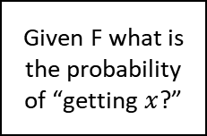
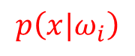
















Bayesian Formulas (with textbook notation)
$$\frac{1}{\sqrt{2π}σ_{F}}e^{−\frac{1}{2}{\left(\frac{h−μ_{F}}{σ_{F}}\right)}^{2}}$$
Given F what is the probability of “getting $x$?”
How often does F occur?
$$P(F)$$
$$p\left(x|F\right)$$
$$P\left(F|x\right)=$$
$$P(F)$$
$$p\left(x|F\right)$$
+
$$P(M)$$
$$p\left(x|M\right)$$
Given $x$ what is the probability of getting $F$?
Given M what is the probability of “getting $x$?”
How often does M occur?
$$\frac{1}{\sqrt{2π}σ_{M}}e^{−\frac{1}{2}{\left(\frac{h−μ_{M}}{σ_{M}}\right)}^{2}}$$
Class conditional probability
A priori probability of $ω_{i}$
$$P\left(ω_{i}\right)$$
$$p\left(x|ω_{i}\right)$$
$$P\left(ω_{i}|x\right)=$$
$$\sum_{j=1}^{2}{P\left(ω_{j}\right) p\left(x|ω_{j}\right)}$$
Posterior probability of $ω_{i}$
(with the understanding that $ω_{1}$ denotes “Female” and $ω_{2}$ denotes “Male”)

Slide 25




Multi-class, multidimensional generalizations
Multiclass classifier, $C$ classes:
$$P\left(ω_{i}|x\right)=\frac{P\left(ω_{i}\right) p\left(x|ω_{i}\right)}{\sum_{j=1}^{C}{P\left(ω_{j}\right) p\left(x|ω_{j}\right)}}$$
With multidimensional features,:
$$P\left(ω_{i}|x\right)=\frac{P\left(ω_{i}\right) p\left(x|ω_{i}\right)}{\sum_{j=1}^{C}{P\left(ω_{j}\right) p\left(x|ω_{j}\right)}}$$
If we find that the distributions are normal (Gaussian), we can simply use training data to find parameters such as the mean and standard deviation and use formulas to compute $p\left(x|ω_{i}\right)$
Other types of data distributions can be constructed as a sum of Gaussians.
Classify a given feature $x$by finding $P\left(ω_{1}|x\right),P\left(ω_{2}|x\right)$, $P\left(ω_{3}|x\right)$ … and choosing the class of the largest of those.
We now have a feature vector $x$ in place of the scalar feature $x$.
Kudos if you are still with me here!

Slide 26


Don’t these textbook formulas look less daunting?
You will also quite easily get this in due course.

Slide 27


Assignment
Data
Queries

Slide 28

How is a histogram constructed?
Data
$$x_{0}$$
$$x_{1}$$
$$x_{2}$$
$$x_{3}$$
$$x_{4}$$
$$x_{5}$$
$$x_{6}$$
$$x_{7}$$
$$x_{8}$$
$$x_{9}$$
.
.
$$x_{N−1}$$
13
12
11
Minimum
7
Maximum
5
4
3
3
2
2
2
2
1
1
1
1
1
1
1
1
1
Bin index
0
1
2
3
4
5
6
7
8
9

Slide 29

Pseudocode for computing the histogram
INPUT:
Data: $\left\{x_{0},x_{1},x_{2},…,x_{N−1}\right\}$ and specification of number of buckets $B$.
OUTPUT:
Histogram: $\left\{h_{0},h_{1},h_{2}, …,h_{B−1}\right\}$ where $h_{b}$ is the count of data samples falling in bin $b$
Initialize all the $h_{b}$ to 0
Find $x_{\text{min}}$ and $x_{\text{max}}$ , the minimum and maximum of the given data set
For $i=0 \text{through} N−1$, do
$b=\text{ROUND}\left(\left(B−1\right)\left(\frac{x_{i}−x_{\text{min}}}{x_{\text{max}}−x_{\text{min}}}\right)\right)$
$h_{b}$=$h_{b}$+1
Return $\left\{h_{0},h_{1},h_{2},…,h_{B−1}\right\}$

Slide 30

How does Alice’s software work?
Key idea: Feature vectors are points in multidimensional space. A lot of ML problems have solutions in geometry.
1.0
1.0
0.5
0.5
1.0
1.0
0.5
0.5
0.5
0.5
1.0
1.0
0.5
0.5
1.0
1.0

Slide 31











How does unsupervised learning work?
Unstructured Data
Place five means at random locations
Find “friends” of each mean
Replace each mean with mean of its set of friends.
Iterate … 1
Replace each mean with mean of its set of friends.
Iterate … 1, 2
Replace each mean with mean of its set of friends.
Iterate … 1, 2, 3
Replace each mean with mean of its set of friends.
Iterate … 1, 2, 3, 4
Replace each mean with mean of its set of friends.
Iterate … 1, 2, 3, 4, 5
Replace each mean with mean of its set of friends.
Iterate … 1, 2, 3, 4, 5, 6
Replace each mean with mean of its set of friends.
Iterate … 1, 2, 3, 4, 5, 6, 7
Replace each mean with mean of its set of friends.
Iterate … 1, 2, 3, 4, 5, 6, 7, 8. DONE!

Slide 32
Topic 1 Summary
Here is what you learned in Topic 1
A working definition of machine learning
... supervised learning
... unsupervised learning
Histograms are easy to understand
Your first classifier: A pair of histograms
Once you understand histogram classifiers, you understand Bayesian classifiers. Because they too are histogram classifiers. Well. Sort of. They are formula-based
A probability density function (PDF) is nothing but a histogram, albeit idealized and normalized
Given an input sample with some features (measurements), classifiers compute the most probable class label by first internally computing all posterior probabilities, and then checking which class is most probable
And then there is another thing. This is a huge insight! But, sorry, you have to do Assignment 1 to get it.

